Slide 1
Smart Thread Machine
Victor Dinh

Slide 2
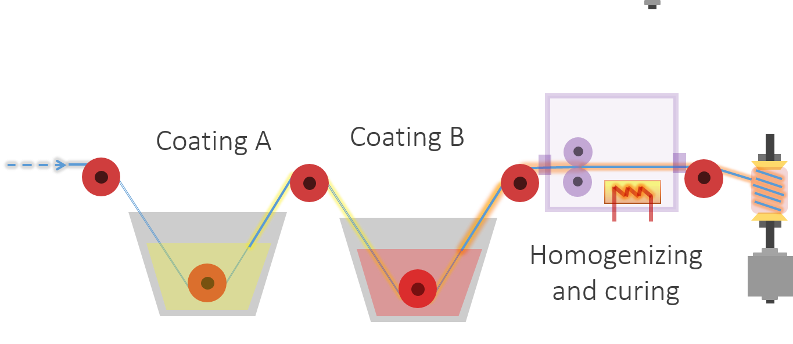
The Idea
Photo creds: Hojat

Slide 3
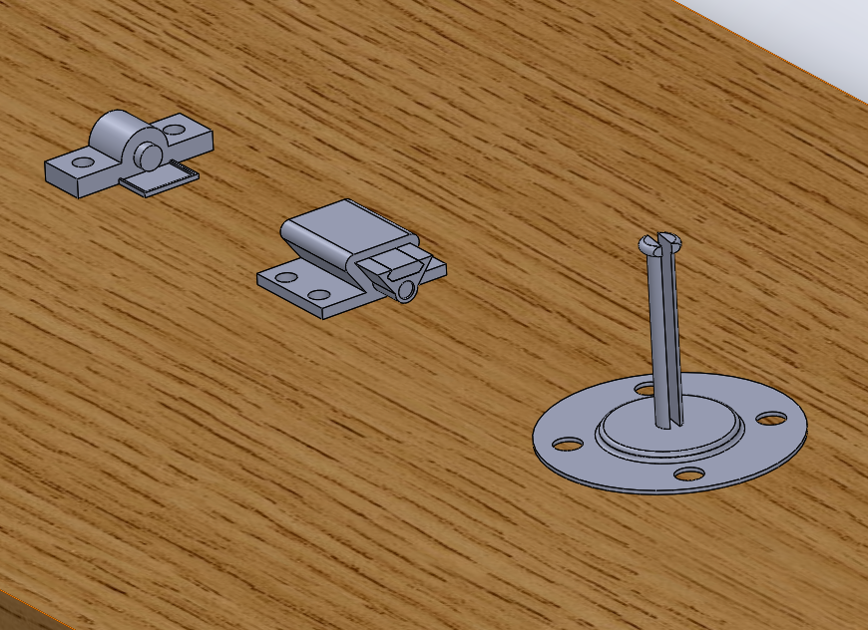
So Far…
Homogenizer
Ink cartridge
Spool holder

Slide 4
Components to build
Build drying mechanism
Build a winch to pull the thread through the machine

Slide 5
Next Steps
Order parts
Learn how to program Arduino and/or Raspberry Pi
Interface sensors with the microcontrollers
Assemble all parts
Test and improve machine

